Slide 1
IBPSES
CT104-3-2-VD1
Fulfillment
Prepared by: NKN First Prepared on: 01.01.12 Last Modified on: 01.02.18
Quality checked by: SKS
Copyright 2012 Asia Pacific University of Technology and Innovation

Slide 2
Functionality
After completing this chapter you will be able to:
Describe the organizational levels associated with the fulfillment process.
List and explain the master data associated with the fulfillment process.
Identify the key steps in the fulfillment process and the data, documents, and information associated with each step.
Discuss the role of the credit management process in fulfillment.
Effectively use SAP® ERP to execute the key steps in the fulfillment process.
Explain how and why fulfillment is integrated with other processes.
Utilize SAP ERP to extract meaningful information about the fulfillment process.

Slide 3
Unit Overview
SD Organizational Structure
SD Master Data
SD Processes
Order-to-Cash Process

Slide 4
Fulfillment
Order fulfillment involves the steps taken in receiving, processing and delivering orders to customers.
This process is also known as the Order-to-Cash Process.

Slide 5
SD Organizational Structure
Client
An independent environment in the system
Company Code
Smallest org unit for which you can maintain a legal set of books
Sales Organization
An organizational unit responsible for the sale of certain products or services.
The responsibility of a sales organization may include legal liability for products and customer claims
Distribution Channel
The way in which products or services reach the customer
Typical examples of distribution channels are wholesale, retail, or direct sales

Slide 6
SD Organizational Structure
Division
A way of grouping materials, products, or services
Sales Area
Combination of Sales Organization, Distribution Channel and Division
Determines conditions (i.e. pricing) for sales activities
Plant (here: Delivering Plant)
Plant from which the goods should be delivered to the customer
Other SD organization units:
Shipping Point
Loading Point
Sales Office
Sales Group
Sales Person

Slide 7
Global Bike Structure for Sales and Distribution
Global Bike
Client
Global Bike Inc.
Global Bike Germany GmbH
Company
Code
US West
US East
Germany North
Germany South
Sales
Organization
San Diego
Dallas
Miami
Hamburg
Heidelberg
Sales Office

Slide 8
GBI Enterprise Structure in SAP ERP (Sales)
Distribution Channel Wholesale WH
Division Accessories AS
Division Bicycles BI
Distribution Channel Internet IN
US West
UW00
CA West
CW00
DE North
DN00
GB North
GN00
AU North
AN00
US East
UE00
CA East
CE00
DE South
DS00
GB South
GS00
AU South
AS00
Sales
Organisation
CC US00
CC CA00
CC DE00
CC GB00
CC AU00
Company Code
Credit Control Area (global) GL00
Client GBI
Notes:
Organizational units displayed in grey are not yet implemented, but are already planned in GBI.

Slide 9
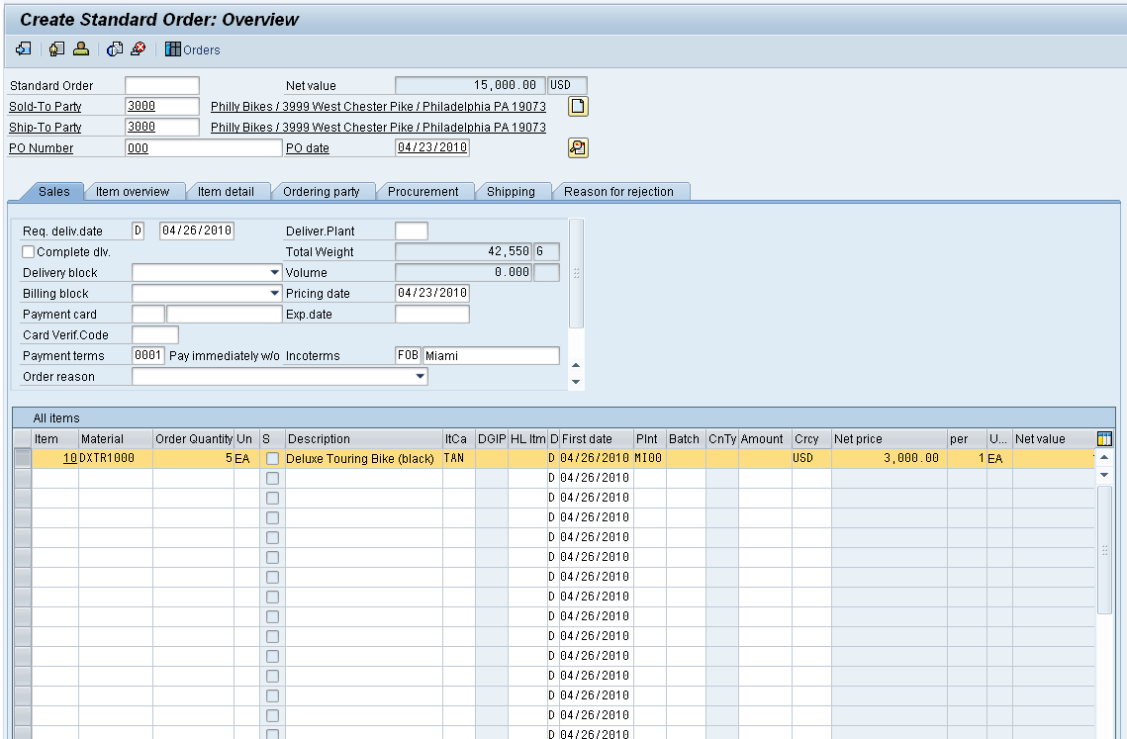
SD Master Data
Customer Master
Material Master
Sales Condition

Slide 10
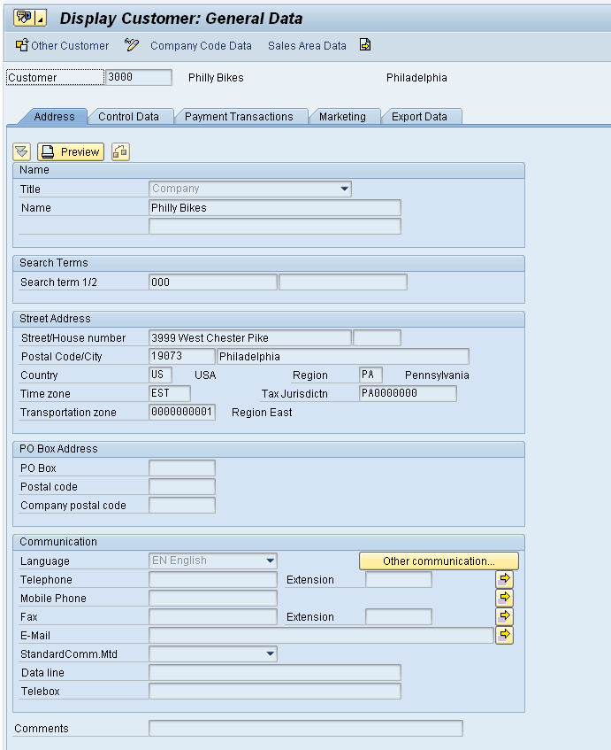
Customer Master Data
Customer Master
Contains all of the information necessary for processing orders, deliveries, invoices and customer payment
Every customer MUST have a master record
Created by Sales Area
Sales Organization
Distribution Channel
Division

Slide 11
Customer Master Data
The customer master information is divided into 3 areas:
General Data
Company Code Data
Sales Area Data

Slide 12
Customer Master
General Information relevant for the entire organization:
Name Address Communication
Client XXX
Company Code specific information:
Acc. Mgmt Payment Bank
Sales Area specific information:
Sales Office Currency
Company Code US00
Sales Org. UW00
Company Code DE00
Sales Org. DS00

Slide 13
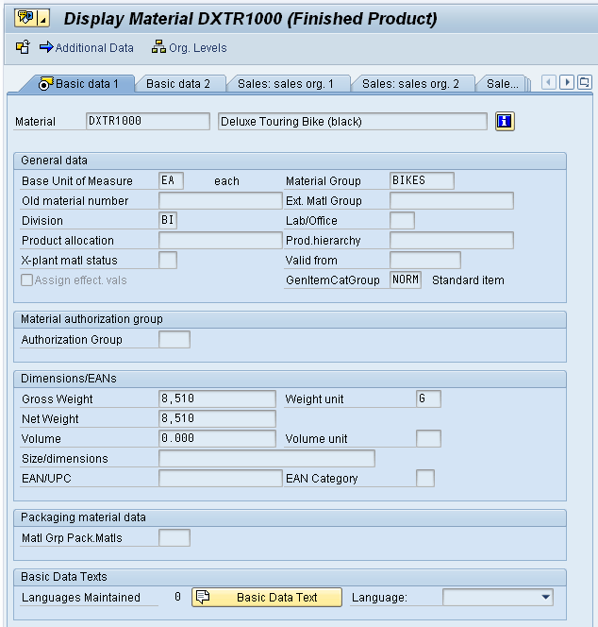
Material Master Data
Material Master
Contains all the information a company needs to manage about a material
It is used by most components within the SAP system
Sales and Distribution
Materials Management
Production
Plant Maintenance
Accounting/Controlling
Quality Management
Material master data is stored in functional segments called Views

Slide 14
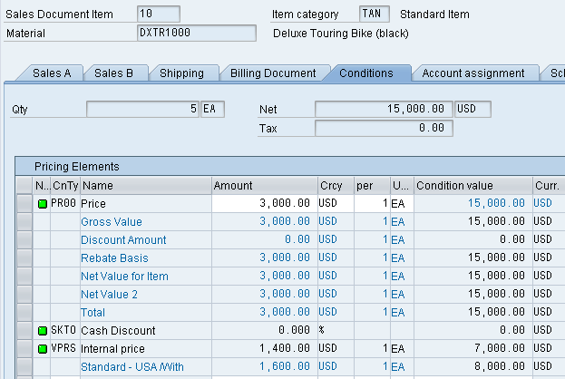
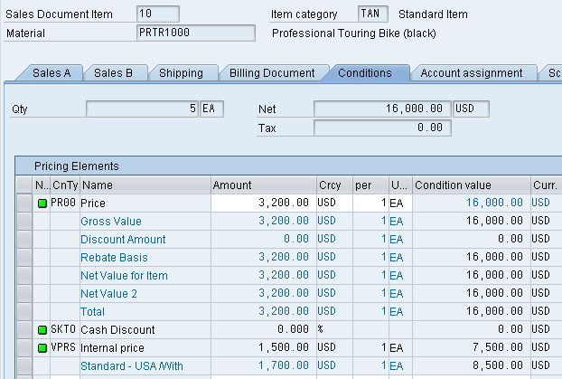
Condition Master Data (Pricing)
Condition master data includes:
Prices
Surcharges
Discounts
Freights
Taxes
You can define the condition master to be dependent on various data:
Material specific
Customer specific
Conditions can be dependent on any document field

Slide 15
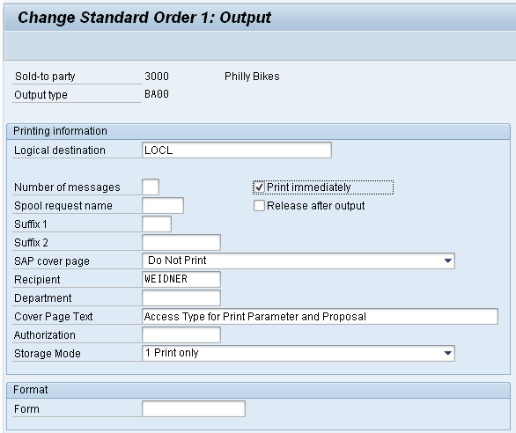
Output
Output is information that is sent to the customer using various media, such as:
E-mail
Mail
EDI
Fax
XML
Output examples:
Quotation
Confirmation
Invoice

Slide 16
Sales Order Process
Pre-sales
Activities
Sales Order
Entry
Check
Availability
Pick
Materials
Receipt of
Customer Payment
Pack
Materials
Invoice
Customer
Post Goods
Issue

Slide 17
Pre-Sales Activities (CRM Light)
Sales Support is a component of SD that assists in the sales, distribution, and marketing of a companies products and services to its customers. It contains the following functionality:
Creating and tracking customer contacts and communications (sales activity)
Phone call records
On-site meeting
Letters
Campaign communication
Implementing and tracking direct mailing, internet, and trade fair campaigns based on customer attributes
Pre-sales documents need to be managed within the presales activities: Inquiries and Quotations. These documents help identify possible sales related activity and determine sales probability.

Slide 18
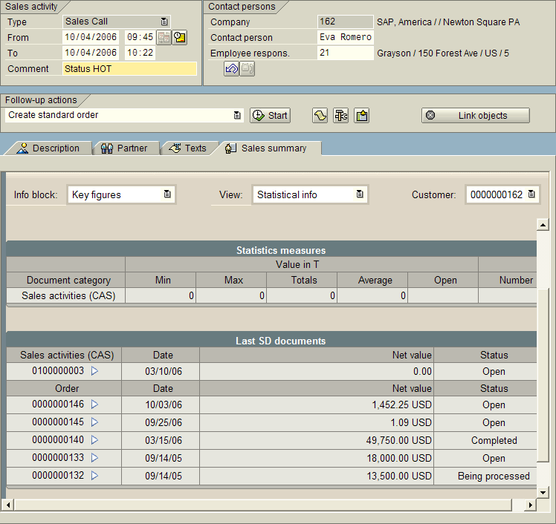
Pre-Sales Activities (CRM Light)
The ultimate goal of all pre-sales activities is to equip the sales technician with all the information necessary to negotiate and complete the potential sale.
Information needed:
Past sales activity
Past communication
Contact information
General Company info
Credit limits and usage
Current backorders
360º view of your customer

Slide 19
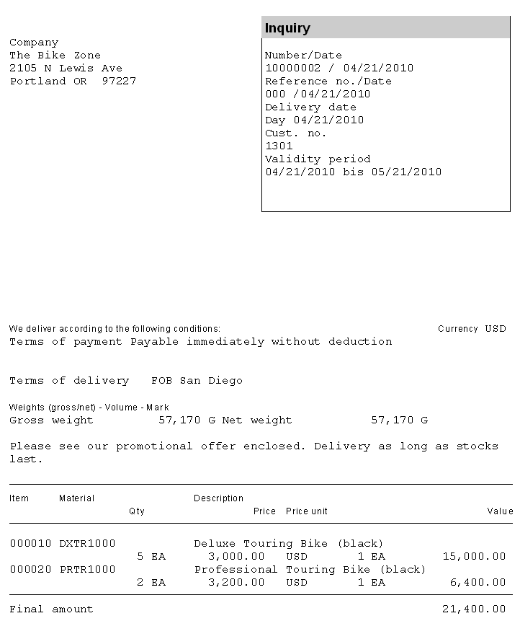
Inquiry
An inquiry is a customer’s request to a company for information or quotation in respect to their products or services without obligation to purchase.
How much will it cost
Material/Service availability
May contain specific quantities and dates
The inquiry is maintained in the system and a quotation is created to address questions for the potential customer.

Slide 20
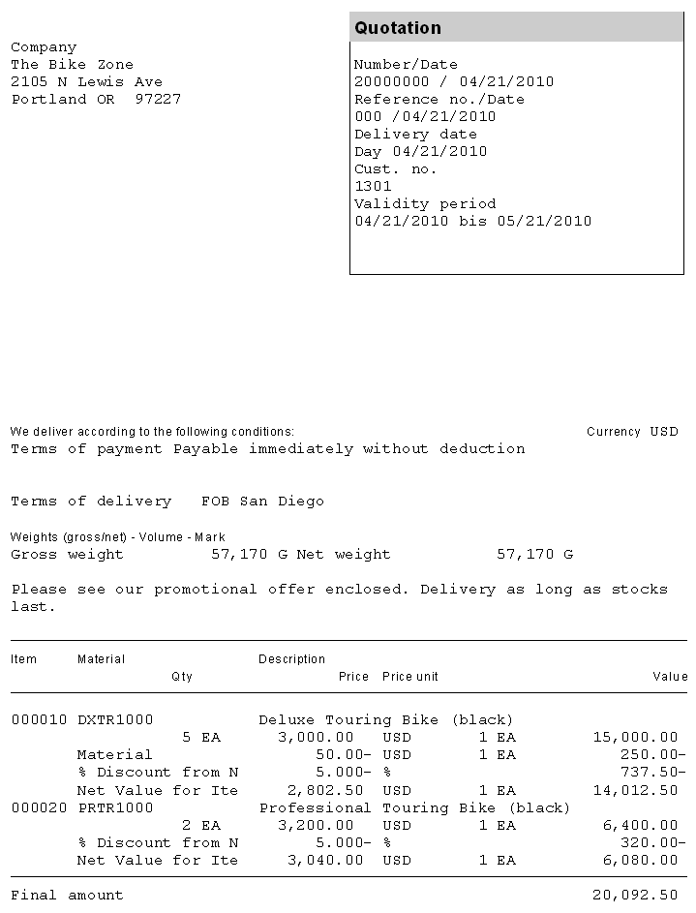
Quotation
The quotation presents the customer with a legally binding offer to deliver specific products or a selection of a certain amount of products in a specified timeframe at a pre-defined price.

Slide 21
Sales Order
Sales order processing can originate from a variety of documents and activities
Customer contacts us for order: phone, internet, email
Existing Contract
Quotations
The electronic document that is created should contain the following basic information:
Customer Information
Material/service and quantity
Pricing (conditions)
Specific delivery dates and quantities
Shipping information
Billing Information

Slide 22
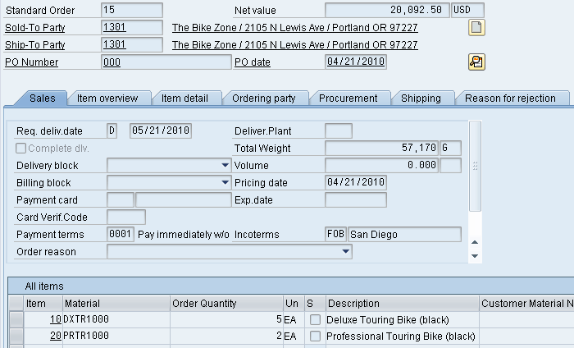
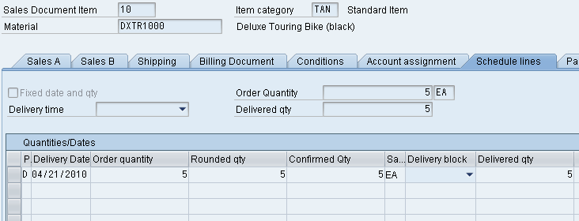
Sales Order
The sales document is made up of three primary areas:
Header
Data relevant for the entire sales order: Ex: customer data, total cost of the order
Line Item(s)
Information about the specific product: Ex: material and quantity, cost of an individual line
Schedule Line(s)
Uniquely belongs to a Line Item, contains delivery quantities and dates for partial deliveries
Screen Diagram Sales Order

Slide 23
Sales Order
The sales order contains all of the information needed to process your customers request, the following information is determined for each sales order:
Delivering Schedule
Shipping point and route determination
Availability Check
Transfer of requirements to MRP
Pricing
Credit limit check

Slide 24
Delivery Scheduling
When an order is created you must enter a requested delivery date for the order or each line item.
The system will then determine a delivery timeline, this will be used when determining our material availability, or ATP (Availability to Promise) date.
The system will determine this date using forward and backward scheduling rules you have defined.

Slide 25
Backward Scheduling
Order
Date
Material
Availability
Transp.
Sched.
Loading
Goods
Issue
Requested
Delv. Date
1st
2nd
3rd
4th
5th
6th
Pick & Pack
Time
(2 days)
Transp.
Sched.
Time
(1 day)
Loading
Time
(1 day)
Transit
Time
(2 days)

Slide 26
Forward Scheduling
Requested
Delv.
Date
New
Delv.
Date
Order
Date
Material
Availability
Transp.
Sched.
Goods
Issue
Loading
1st
2nd
3rd
4th
5th
6th
7th
Transp.
Sched.
Time
(1 day)
Loading
Time
(1 day)
Transit
Time
(2 days)
Pick & Pack
Time (2 days)

Slide 27
Shipping & Route Determination
During the creation of the sales order the system must determine the shipping point from which the material will be shipped and the route the material will take to get from your warehouse to your customers location.
A shipping point is determined for each line item within the order.
The route determination will is used to define the transit time of the material that we used in scheduling.

Slide 28
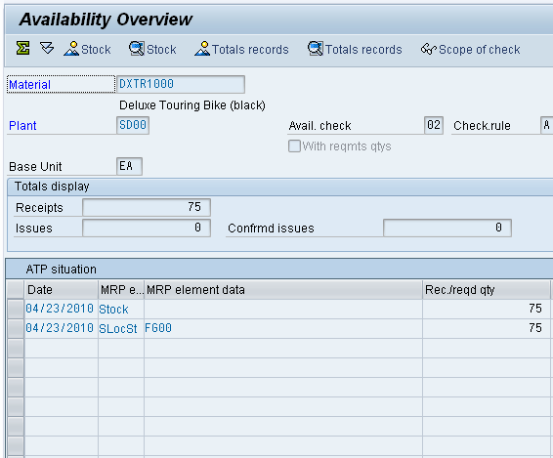
Availability Check
Availability Check
Determines the material availability date
Considers all inward and outward inventory movements
Proposes 3 methods of delivery
One-time delivery
Complete delivery
Delayed proposal
Rules are created by YOU

Slide 29
Pricing
The system displays pricing information for all sales documents on the pricing screens at both the header and the line item level.
Header pricing is valid for the whole order it is the cumulative of all line items within the order
Line item pricing is for each specific material.
The system will automatically search for price, discounts, surcharges, calculate taxes and freight. You have the ability to manually manipulate the pricing at both the header and line item level within the sales order by entering a condition type and amount.
Taxes and freight can be set-up so we can’t manually enter

Slide 30
Shipping & Transportation
The shipping process begins when you create the delivery document for the sales order. This document controls, supports, and monitors numerous sub-processes for shipping processing:
Picking
Packing
Post Goods Issue
Integrated with the Material Management (MM) and Finance (FI) modules

Slide 31
Shipping
Sales Order 1
Sales Order 4
Sales Order 5
Sales Order 2
Delivery 8…13
Delivery 8…16
Sales Order 3
Delivery 8…14
Delivery 8…12
Delivery 8…15
Order
Combination
Partial
Delivery
Complete
Delivery

Slide 32
Delivery Creation
Checks order and materials to determine if a delivery is possible — delivery block (hold), completeness
Confirms availability
Confirms export/foreign trade requirements
Determines total weight & volume
Notes:
The system carries out the following activities when an outbound delivery is created:
Checks the order and materials to make sure the outbound delivery is possible (for example, it checks for delivery blocks or incompleteness)
Determines the delivery quantity of an item and checks the availability of the material
Calculates the weight and volume of the delivery
Calculates work expenditure
Packs the outbound delivery according to the reference order
Checks the delivery situation of the order and any partial delivery agreements
Redetermines the route
Adds information relevant for export
Checks delivery scheduling and changes deadlines (if necessary)
Assigns a picking location
Carries out batch determination (if material is to be handled in batches)
Creates an inspection lot if the material must pass a quality check
Updates sales order data and changes order status

Slide 33
Delivery Creation
Generates packing proposal
Calculates weight and volume
Checks scheduling
Considers partial deliveries
Updates route assignment
Assigns picking location
Updates sales order
Determines batches
Quality check (if needed)
Updates sales order

Slide 34
Delivery Document
The Delivery Document initiates the delivery process and is the control mechanism for this process
Picking
Packing
Loading
Posting Goods Issue
Changes to delivery are allowable - products, quantities
Notes:
Changes in delivery will update the sales order.

Slide 35
Picking
Quantities based on delivery note
Assigned date when picking should begin
Automated storage location assignment
Supports serial number/lot number tracking and batch management
Integrated with Warehouse Management (WM)
Notes:
In the system standard settings, it is a prerequisite for goods issue to be posted before the item relevant for picking can be picked completely. Therefore, delivery quantity and picking quantity (picked quantity) in the outbound delivery must be equal.
Considering the picking lead time the picking date will be assigned based upon material availability
The picking process involves taking goods from a storage location and staging the right quantity in a picking area where the goods will be prepared for shipping.
Depending on the picking procedure being used, you can either determine delivery-relevant data before picking or wait until after picking is completed to record it. Delivery-relevant data may be made up of the following:
Which batches a material is picked from
Which serial numbers are picked
Which valuation types the stock is taken from
The use of the WM transfer order as a picking order offers you the following advantages:
Determining of target data for transfer orders
Splitting transfer orders according to target data
Printing transfer orders or transmitting them in IDoc format
Determining actual data for picking with option of executing incentive wage calculations using the Human Resources (HR) module
Confirming transfer orders

Slide 36
Loading and Packing
Identifies which packaging is to be used for specified products (customer preference and UCC-128 considerations)
Identifies and updates accounts associated with returnable packaging
Tracks the packed product by container
Insures weight/volume restrictions are enforced
All packed items are assigned to the required means of transportation
Notes:
The Packing component and related packing information enables you to:
Update the stock situation of packing materials
Monitor returnable packaging stocks at the customer's or forwarding agent's place of business
Help you find you what was in a particular container (for example, if a customer maintains that they have received an incomplete delivery)
Make sure that the weight and volume limits have been adhered to
Ensure that products have been packed correctly
UCC-128: Universal Container Code – Uniform packing code

Slide 37
Goods issue
Event that indicates the legal change in ownership of the products
Reduces inventory and enters Cost of Goods Sold
Automatically updates the General Ledger (G/L) accounts
Ends the shipping process and updates the status of the shipping documents
Notes:
As soon as the goods leave the company, the shipping business activity is finished.
The outbound delivery forms the basis of goods issue posting. The data required for goods issue posting is copied from the outbound delivery into the goods issue document, which cannot be changed manually. Any changes must be made in the outbound delivery itself. In this way, you can be sure that the goods issue document is an accurate reflection of the outbound delivery.
When you post goods issue for an outbound delivery, the following functions are carried out on the basis of the goods issue document:
Warehouse stock of the material is reduced by the delivery quantity
Value changes are posted to the balance sheet account in inventory accounting
Requirements are reduced by the delivery quantity
The serial number status is updated
Goods issue posting is automatically recorded in the document flow
Stock determination is executed for the vendor's consignment stock
A worklist for the proof of delivery is generated
A worklist for the proof of delivery is generated
After goods issue is posted for an outbound delivery, the scope for changing the delivery document becomes very limited. This prevents there being any discrepancies between the goods issue document and the outbound delivery.

Slide 38
Billing
The billing document is created by coping data from the sales order and/or delivery document.
Order-based billing
Delivery-based billing
The billing process is used to generate the customer invoice.
It will update the customer’s credit status.
Notes:
Billing represents the final processing stage for a business transaction in Sales and Distribution. Information on billing is available at every stage of order processing and delivery processing.
This component includes the following functions:
Creation of:
Invoices based on deliveries or services
Issue credit and debit memos
Pro forma invoices
Cancel billing transactions
Comprehensive pricing functions
Issue rebates
Transfer billing data to Financial Accounting (FI)

Slide 39
Billing Documents
The billing document will automatically create a debit posting to your customer sub-ledger account and credit your revenue account.
It is at this point that the sales process is passed over to Financial Accounting to await payment.
Notes:
Creating Billing Documents Explicitly
Purpose
If you only have to bill specific orders or deliveries, you can carry out manual billing explicitly.
When processing the billing due list, you do not need to enter the individual documents to be invoiced. The system lists the documents to be invoiced on the basis of the selection criteria you enter. It can also combine several deliveries in one invoice.
Process Flow
You select the function for creating a billing due list.
You enter the selection criteria for the billing documents to be created. For example, enter billing type F2, if you only want to create invoices with this billing type.
You then display the billing due list.
The system uses the selection criteria to create the billing due list (a list of sales documents to be billed). You can now process this list, e.g. select some or all of the sales documents to be billed.
You select the function for billing. The system creates the corresponding billing documents for the selected documents.
Automatic Posting to Finance (next slide)

Slide 40
Billing Methods
Delivery based Invoicing
Delivery 8…20
Invoice 9…45
Order 6
Delivery 8…21
Invoice 9…46
Delivery 8…33
Collective
Invoicing
Order 9
Delivery 8…34
Invoice 9…68
Order 14
Delivery 8…56
Split
Invoicing
Invoice 9…91
Order 32
Delivery 8…86
Invoice 9…92
Notes:
You can set the system to create one billing document for each sales document, e.g. one invoice per delivery.
As long as certain data agrees, you can also combine different documents (orders and/or deliveries) fully or partially in a common billing document:
If you want to guarantee that invoices are created separately according to certain criteria, you can do this by defining certain split criteria.

Slide 41
Payment
Payment is the final step in the sales order process, this step is managed by the Financial Accounting department.
Final payment includes:
Posting payments against invoices.
Reconciling differences between payment and invoice.
Payment will create a posting clearing the liability in the A/R account and increases your bank account.

Slide 42
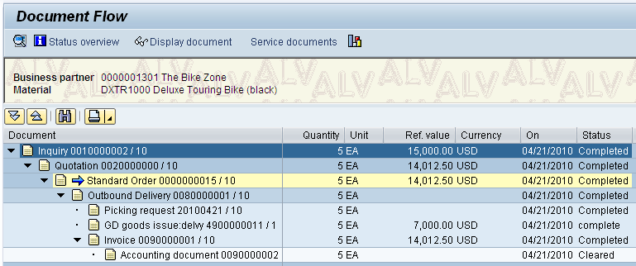
Document Flow
The document flow and order status feature allows you to find the status of an order at any point in time. The SAP updates the order status every time a change is made to any document created in the customer order management cycle
(Order-to-Cash).
Document Flow

Slide 43
Sales Order Process Debugging
“Never again did I learn so much in such a short time, because twenty participants made mistakes for me! You cannot make so many mistakes all alone”
SAP Co-founder Klaus Tschira, on his experiences teaching COBOL to clients at IBM.

Slide 44
Sales Order Process Debugging
Document Flow
Gives Order Process Status
List of Sales Orders (VA05)
Tool to Find Order
Need student’s user id/data set number

Slide 45
Question and Answer Session
Q & A

Slide 46
What we will cover next
Material Management

